Slide 1
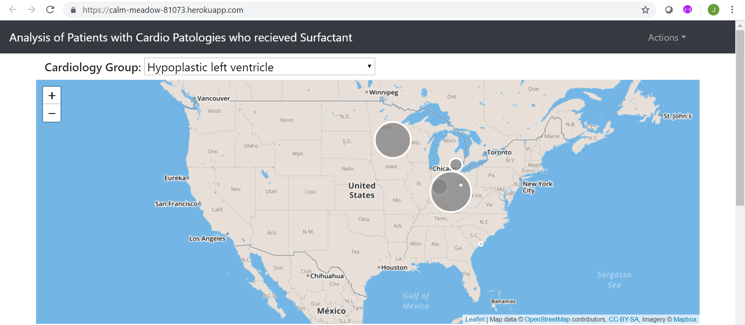
Analysis of Patients with Cardio Pathologies who were treated with Surfactant

Slide 2
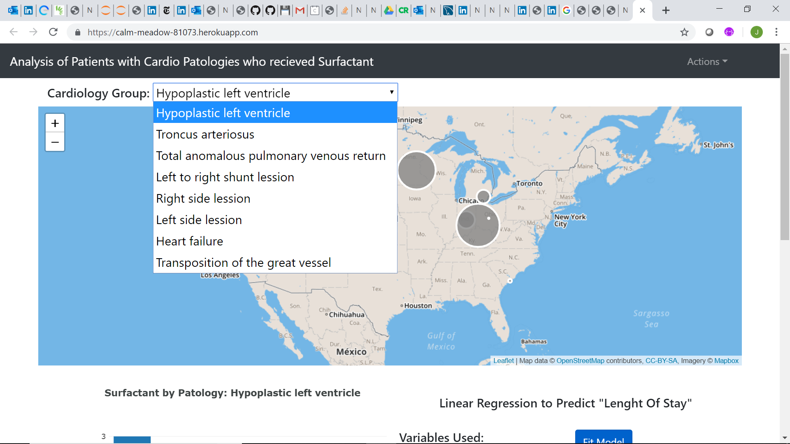
Pathology Groups:
Hypoplastic Left Ventricle
Troncus Arteriosus
Total anomalous pulmonary venous return
Left to right shunt lesion
Right side lesion
Left side lesion
Heart failure
Transposition of the great vessel

